Slide 1
Recursion
Algorithm : Design & Analysis
[3]

Slide 2
In the last class…
Asymptotic growth rate
The Sets Ο, Ω and Θ
Complexity Class
An Example: Maximum Subsequence Sum
  Improvement of Algorithm
  Comparison of Asymptotic Behavior
Another Example: Binary Search
  Binary Search Is Optimal

Slide 3
Recursion
Recursive Procedures
Proving Correctness of Recursive Procedures
Deriving recurrence equations
Solution of the Recurrence equations
  Guess and proving
  Recursion tree
  Master theorem
Divide-and-conquer

Slide 4
Recursion for Algorithm
Recurrence relations
Computing n!
  if n=1 then return 1 else return Fac(n-1)*n
M(1)=0 and M(n)=M(n-1)+1 for n>0
(critical operation: multiplication)
Hanoi Tower
  if n=1 then move d(1) to peg3 else
  { Hanoi(n-1, peg1, peg2); move d(n) to peg3; Hanoi(n-1, peg2, peg3)
  M(1)=1 and M(n)=2M(n-1)+1 for n>1
  (critical operation: move)

Slide 5

Counting the Number of Bit
Input: a positive decimal integer n
Output: the number of binary digits in n’s binary representation
Int BinCounting (int n)
1. if (n==1) return 1;
2. else
3. return BinCounting(n div 2)+(n mod 2);

Slide 6
Correctness of BinCounting
Proof by induction
Base case: if n =1, trivial by line 1.
Inductive hypothesis: for any 0<k<n, BinCounting(k) return the correct result.
Induction
  If n≠1 then line 3 is executed
  (n div 2) is a positive decimal integer (so, the precondition for BinCounting is still hold), and
  0<(n div 2)<n, so, the inductive hypothesis applies
  So, the correctness (the number of bit of n is one more than that of (n div 2)

Slide 7
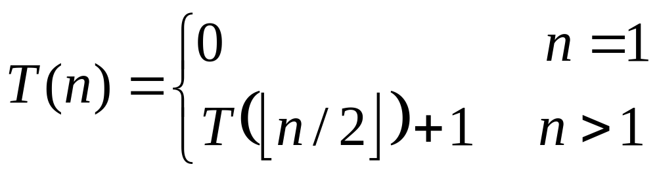
Complexity Analysis of BinCounting
The critical operation: addition
The recurrence relation

Slide 8
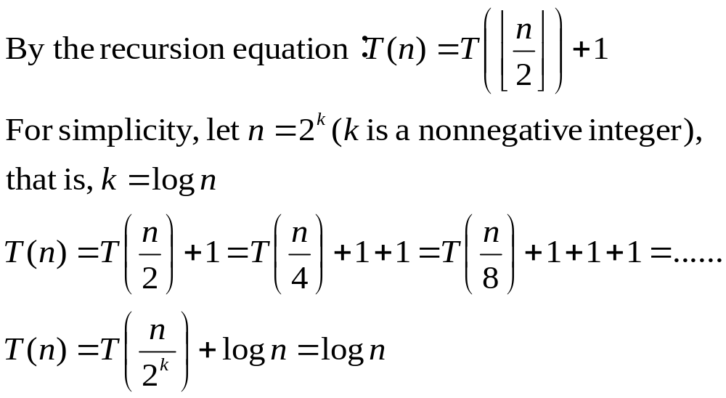
Solution by backward substitutions
( T(1)=0 )

Slide 9
Smooth Functions
Let f(n) be a nonnegative eventually non-decreasing function defined on the set of natural numbers, f(n) is called smooth if f(2n)∈Θ(f(n)).
Note: logn, n, nlogn and n^{α} (α≥0) are all smooth.
  For example: 2nlog2n = 2n(logn+log2)∈Θ(nlogn)
Notes:
哪些是smooth function，比如 nlogn,n^k,c^n

Slide 10
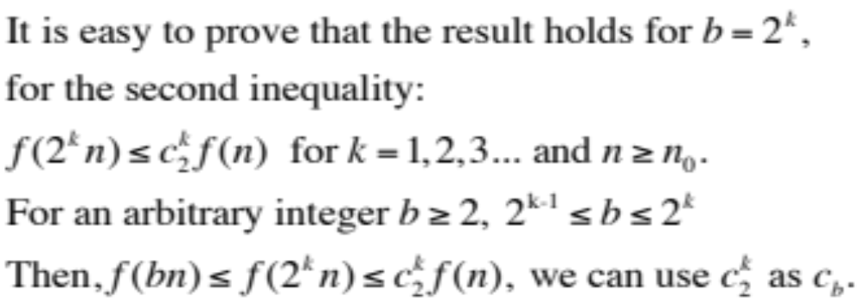
Even Smoother
Let f(n) be a smooth function, then, for any fixed integer b≥2, f(bn)∈Θ(f(n)).
That is, there exist positive constants c_{b} and d_{b} and a nonnegative integer n₀ such that
d_{b}f(n) ≤ f(bn) ≤ c_{b}f(n) for n≥n₀.
Notes:
/Theta=O+/Omega,
左式显然，主要证明右式

Slide 11

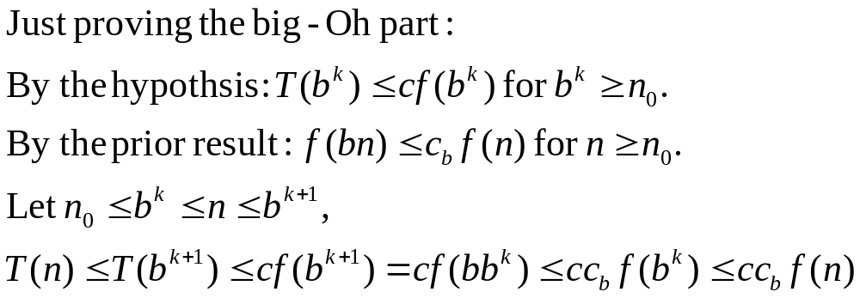
Smoothness Rule
Let T(n) be an eventually nondecreasing function and f(n) be a smooth function. If T(n)∈Θ(f(n)) for values of n that are powers of b(b≥2), then T(n)∈Θ(f(n)).
Non-decreasing
hypothesis
Prior result
Non-decreasing

Slide 12
Computing the nth Fibonacci Number
f₁=1
f₂=1
f_{n}= f_{n-1}+ f_{n-2}
0, 1, 1, 2, 3, 5, 8, 13, 21, 34, ......
is called linear homogeneous relation of degree k.
For the special case of Fibonacci: a_{n}=a_{n-1}+a_{n-2}, r₁=r₂=1

Slide 13
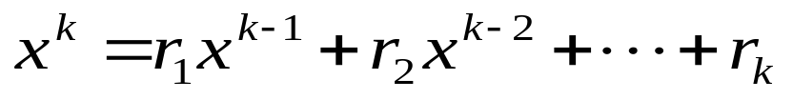
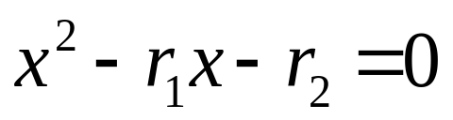
Characteristic Equation
For a linear homogeneous recurrence relation of degree k
the polynomial of degree k
is called its characteristic equation.
The characteristic equation of linear homogeneous recurrence relation of degree 2 is:

Slide 14
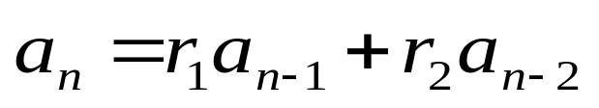
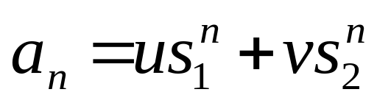
Solution of Recurrence Relation
If the characteristic equation of the recurrence relation has two distinct roots s₁ and s₂, then
where u and v depend on the initial conditions, is the explicit formula for the sequence.
If the equation has a single root s, then, both s₁ and s₂ in the formula above are replaced by s

Slide 15
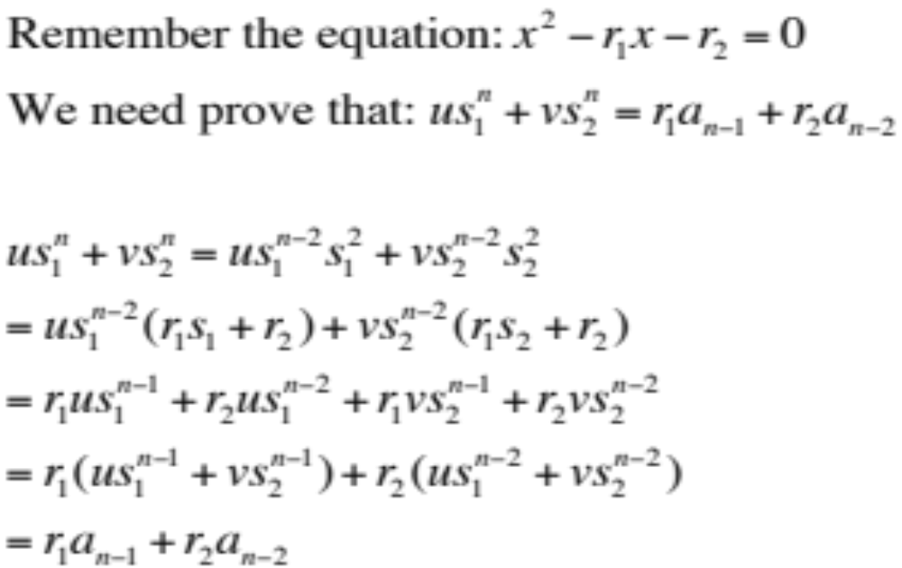
Proof of the Solution

Slide 16
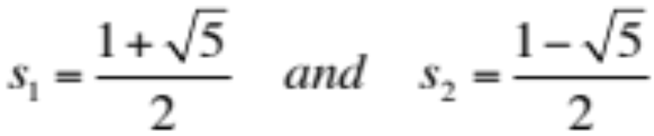
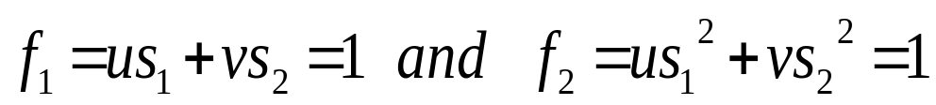

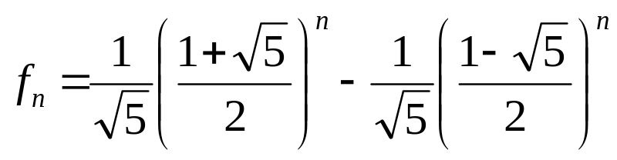
Return to Fibonacci Sequence
f₁=1
f₂=1
f_{n}= f_{n-1}+ f_{n-2}
0, 1, 1, 2, 3, 5, 8, 13, 21, 34, ......
Explicit formula for Fibonacci Sequence
The characteristic equation is x²-x-1=0, which has roots:
Note: (by initial conditions)
which results:

Slide 17
Maximum Subsequence Sum：Divide-and-Conquer
Part 1
Part 2
the sub with largest sum may be in:
recursion
Part 1
Part 2
or:
The largest is the result
Part 1
Part 2
T(n)=2T(n/2) +n (n=2k)

Slide 18
Guess the Solutions
Example: T(n)=2T(⎣n/2⎦) +n
Guess
  T(n)∈O(n)?
    T(n)≤cn, to be proved for c large enough
  T(n)∈O(n²)?
    T(n)≤cn², to be proved for c large enough
  Or maybe, T(n)∈O(nlogn)?
    T(n)≤cnlogn, to be proved for c large enough
T(n) = 2T(⎣n/2⎦)+n
≤ 2(c⎣n/2⎦ log (⎣n/2⎦))+n
≤ cnlog (n/2)+n
= cn log n – cn log 2 +n
= cn log n – cn + n
≤ cn log n for c≥1

Slide 19
Recursion Tree
T(size)
nonrecursive cost
T(n)
n
T(n/2)
n/2
T(n/2)
n/2
T(n/4)
n/4
T(n/4)
n/4
T(n/4)
n/4
T(n/4)
n/4
The recursion tree for T(n)=T(n/2)+T(n/2)+n

Slide 20
Recursion Tree Rules
Construction of a recursion tree
  work copy: use auxiliary variable
  root node
  expansion of a node:
    recursive parts: children
    nonrecursive parts: nonrecursive cost
  the node with base-case size

Slide 21
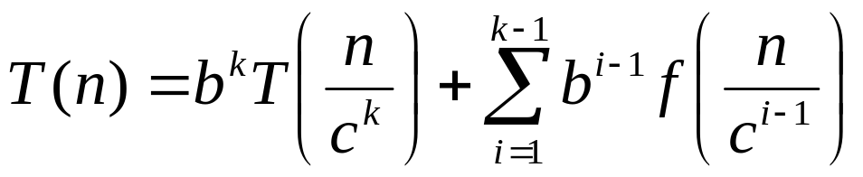
Recursion tree equation
For any subtree of the recursion tree,
  size field of root =
  Σ nonrecursive costs of expanded nodes +
  Σ size fields of incomplete nodes
Example: divide-and-conquer:
  T(n) = bT(n/c) + f(n)
  After kth expansion:

Slide 22
Evaluation of a Recursion Tree
Computing the sum of the nonrecursive costs of all nodes.
Level by level through the tree down.
Knowledge of the maximum depth of the recursion tree, that is the depth at which the size parameter reduce to a base case.

Slide 23
Recursion Tree
Work copy: T(k)=T(k/2)+T(k/2)+k
T(n)=nlgn
T(n)
n
T(n/2)
n/2
T(n/2)
n/2
n/2^{d}
(size →1)
T(n/4)
n/4
T(n/4)
n/4
T(n/4)
n/4
T(n/4)
n/4
At this level: T(n)=n+2(n/2)+4T(n/4)=2n+4T(n/4)

Slide 24
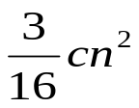
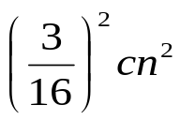

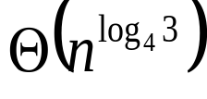
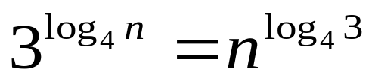
Recursion Tree for
T(n)=3T(⎣n/4⎦)+Θ(n²)
cn²
cn²
c(¼ n)²
c(¼ n)²
c(¼ n)²
log₄n
c((1/16)n)²
c((1/16)n)²
……
c((1/16)n)²
c((1/16)n)²
……
c((1/16)n)²
……
……
…
T(1)
T(1)
T(1)
T(1)
T(1)
T(1)
T(1)
T(1)
T(1)
T(1)
T(1)
T(1)
T(1)
T(1)
Note:
Total: Θ(n²)

Slide 25


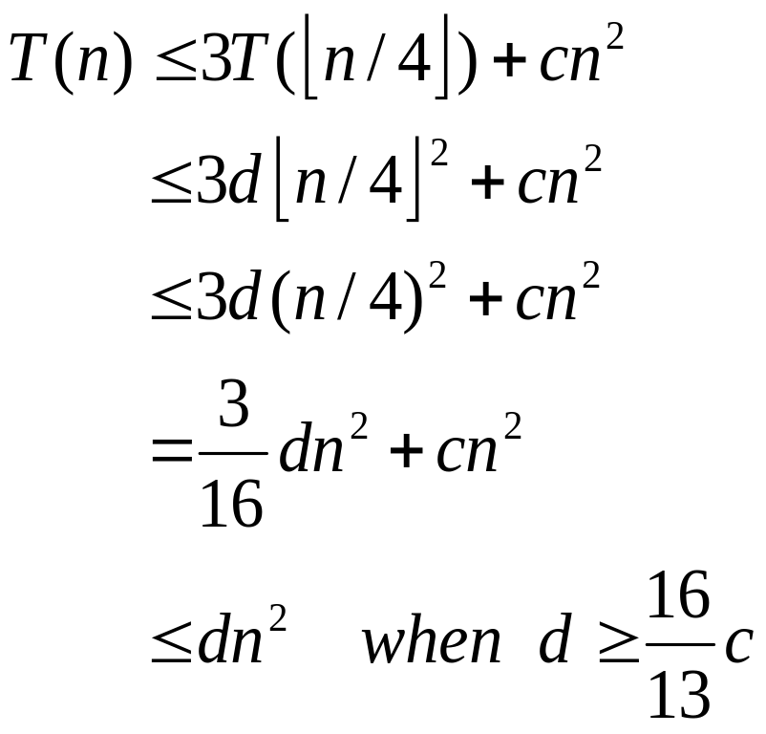
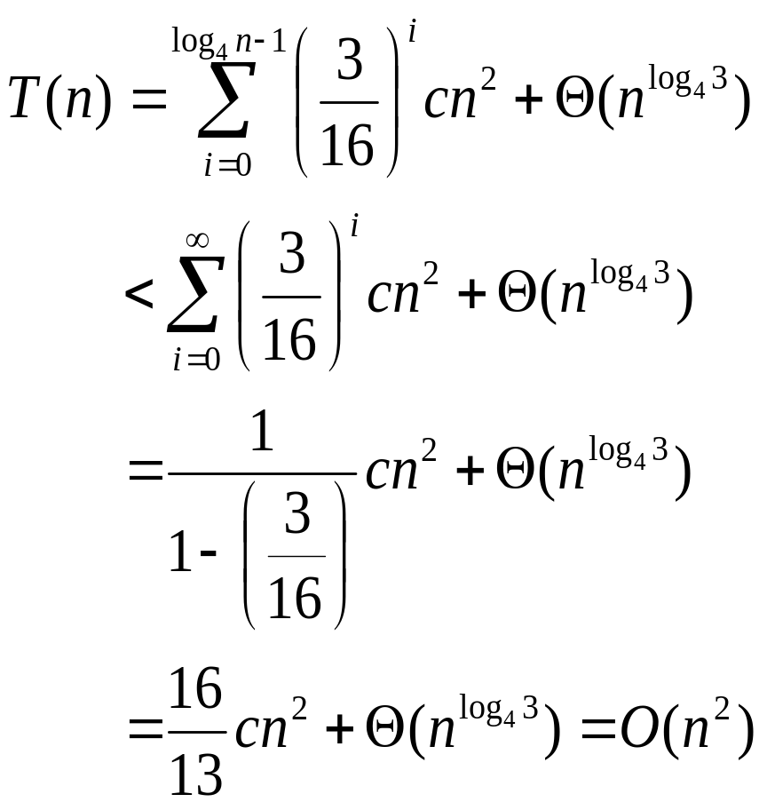
Verifying “Guess” by Recursive Tree
Inductive hypothesis

Slide 26


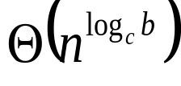
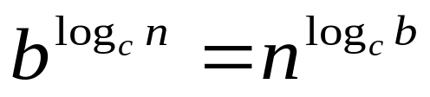
Recursion Tree for
T(n)=bT(n/c)+f(n)
f(n)
f(n)
b
f(n/c)
f(n/c)
f(n/c)
b
log_{c}n
f(n/c²)
f(n/c²)
f(n/c²)
f(n/c²)
f(n/c²)
f(n/c²)
f(n/c²)
f(n/c²)
f(n/c²)
……
……
…
T(1)
T(1)
T(1)
T(1)
T(1)
T(1)
T(1)
T(1)
T(1)
T(1)
…
T(1)
T(1)
T(1)
Note:
Total ?

Slide 27
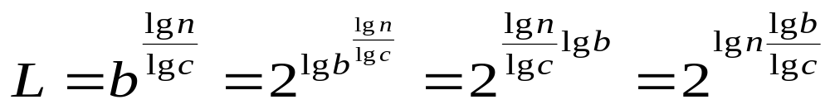
Solving the Divide-and-Conquer
The recursion equation for divide-and-conquer, the general case:T(n)=bT(n/c)+f(n)
Observations:
  Let base-cases occur at depth D(leaf), then n/c^{D}=1, that is D=lg(n)/lg(c)
  Let the number of leaves of the tree be L, then L=b^{D}, that is L=b^{(lg(n)/lg(c))}.
  By a little algebra: L=n^{E}, where E=lg(b)/lg(c), called critical exponent.

Slide 28
Divide-and-Conquer: the Solution
The recursion tree has depth D=lg(n)/ lg(c), so there are about that many row-sums.
The 0th row-sum is f(n), the nonrecursive cost of the root.
The Dth row-sum is n^{E}, assuming base cases cost 1, or Θ(n^{E}) in any event.
The solution of divide-and-conquer equation is the non-recursive costs of all nodes in the tree, which is the sum of the row-sums.

Slide 29
Solution by Row-sums
[Little Master Theorem] Row-sums decide the solution of the equation for divide-and-conquer:
  Increasing geometric series: T(n)∈Θ(n^{E})
  Constant: T(n)∈Θ (f(n) log n)
  Decreasing geometric series: T(n)∈Θ (f(n))
This can be generalized to get a result not using explicitly row-sums.

Slide 30
Master Theorem
The positive ε is critical, resulting gaps between cases as well
Loosening the restrictions on f(n)
  Case 1: f(n)∈O(n^{E-ε}), (ε>0), then:
  T(n)∈Θ(n^{E})
  Case 2: f(n)∈Θ(n^{E}), as all node depth contribute about equally:
  T(n)∈Θ(f(n)log(n))
  case 3: f(n)∈Ω(n^{E+ε}), (ε>0), and f(n)∈O(n^{E+δ}), (δ≥ε), then:
  T(n)∈Θ(f(n))

Slide 31

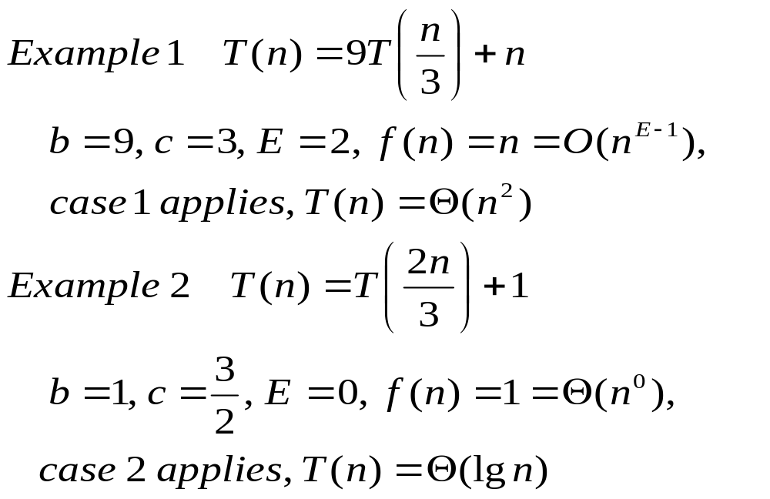
Using Master Theorem

Slide 32
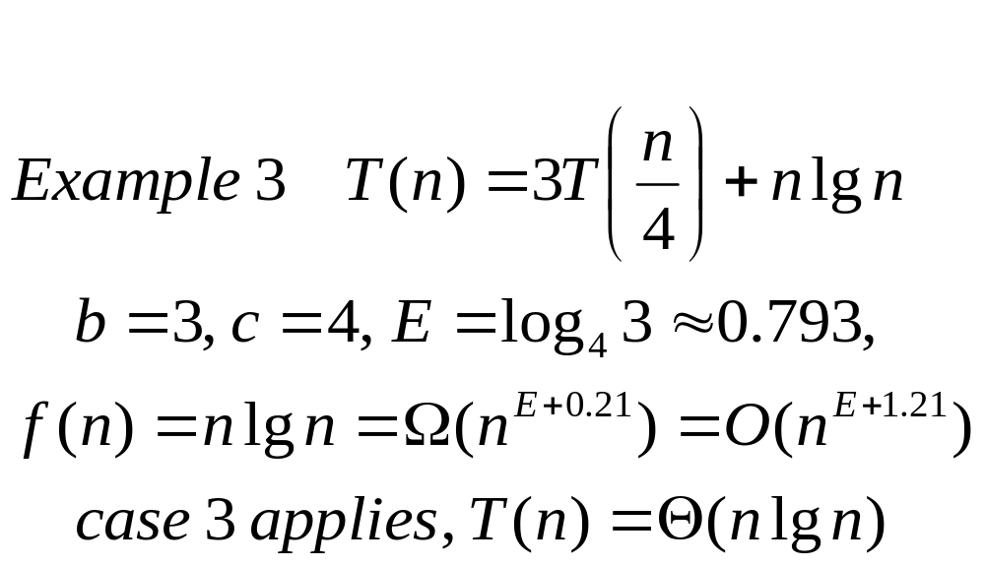
Using Master Theorem

Slide 33
Looking at the Gap
T(n)=2T(n/2)+nlgn
  a=2, b=2, E=1, f(n)=nlgn
  We have f(n)=Ω(n^{E}), but no ε>0 satisfies f(n)=Ω(n^{E+ε}), since lgn grows slower that n^{ε} for any small positive ε.
  So, case 3 doesn’t apply.
  However, neither case 2 applies.

Slide 34
Home Assignment
pp.143-
  3.4
  3.6
  3.9-3.11

